Slide 1

REBAR: Retrieval-based Reconstruction for Time-series Contrastive Learning
Maxwell A. Xu¹, Alexander Moreno¹, Hui Wei³, Benjamin M. Marlin³, James M. Rehg²
¹Georgia Institute of Technology, ²University of Illinois Urbana-Champaign ³University of Massachusetts Amherst
Maxwell A. Xu¹, Alexander Moreno², Supriya Nagesh¹, V. Burak Aydemir¹, David W. Wetter³, Santosh Kumar⁴, James M. Rehg¹
¹Georgia Institute of Technology, ²Luminous Computing, ³University of Utah, ⁴University of Memphis
Presented at ICLR 2024
Notes:
Hello, My name is Maxwell Xu, and I will be presenting our work on REBAR: Retrieval-based Reconstruction for Time-series Contrastive Learning

Slide 2

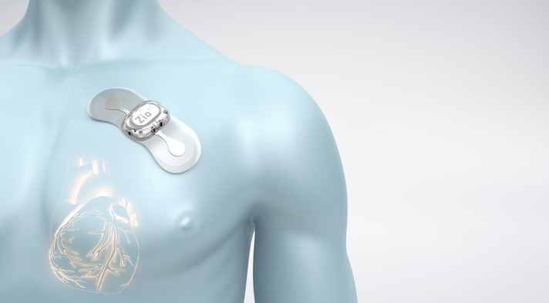
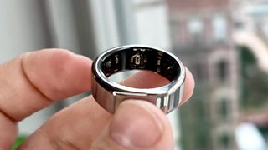
Self-supervised Contrastive Learning
Advances in wearable sensors technology → Large volumes of unlabeled health time-series signals
Notes:
We frame our challenge around mobile health, the study of how mobile devices can be used to track and enable healthy behaviors to hopefully prevent chronic diseases
This is typically done through sensors that continuously and noninvasively monitor our given conditions.

Slide 3
Self-supervised Contrastive Learning
Advances in wearable sensors technology → Large volumes of unlabeled health time-series signals
Self-supervised learning exploits underlying structure of the data to learn rich representations, without labels
Contrastive learning learns an embedding by pushing positive pairs together and negative pairs apart.
The positive pairs must be similar enough to share semantic meaning but different enough to capture within-class variation
Positive
Anchor
Negatives
Notes:
We frame our challenge around mobile health, the study of how mobile devices can be used to track and enable healthy behaviors to hopefully prevent chronic diseases
This is typically done through sensors that continuously and noninvasively monitor our given conditions.

Slide 4
Self-supervised Contrastive Learning
Advances in wearable sensors technology → Large volumes of unlabeled health time-series signals
Self-supervised learning exploits underlying structure of the data to learn rich representations, without labels
Contrastive learning learns an embedding by pushing positive pairs together and negative pairs apart.
The positive pairs must be similar enough to share semantic meaning but different enough to capture within-class variation
Positive
Anchor
Negatives
How can we identify meaningful positive pairs, without labels?
Notes:
We frame our challenge around mobile health, the study of how mobile devices can be used to track and enable healthy behaviors to hopefully prevent chronic diseases
This is typically done through sensors that continuously and noninvasively monitor our given conditions.

Slide 5
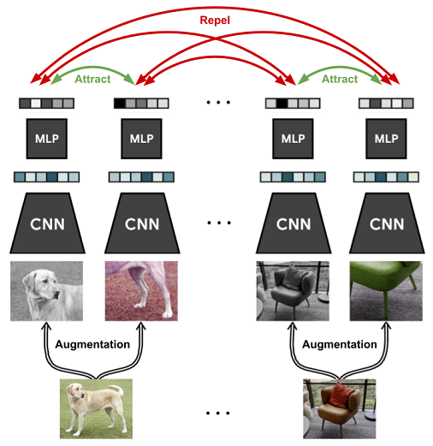
Positive Pairs in Prior Work (1/2)
Augmentation-based Approaches
Originate from vision domain
SimCLR Approach

Slide 6
Positive Pairs in Prior Work (1/2)
Augmentation-based Approaches
Originate from vision domain
Cameras have a much better-established set of invariances compared to time-series
SimCLR Approach

Slide 7
Positive Pairs in Prior Work (1/2)
Augmentation-based Approaches
Originate from vision domain
Cameras have a much better-established set of invariances compared to time-series
↓
Inconsistent set of augmentations in time-series approaches
TF-C uses jittering+scaling while TS2Vec explicitly excludes them
SimCLR Approach

Slide 8
Positive Pairs in Prior Work (1/2)
Augmentation-based Approaches
Originate from vision domain
Cameras have a much better-established set of invariances compared to time-series
↓
Inconsistent set of augmentations in time-series approaches
TF-C uses jittering+scaling while TS2Vec explicitly excludes them
SimCLR Approach

Slide 9
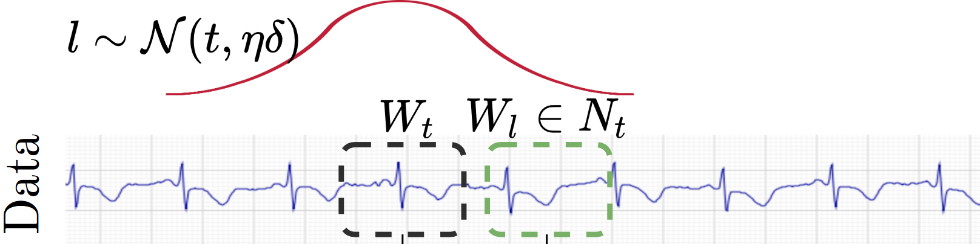
Positive Pairs in Prior Work (2/2)
Sampling-based Approaches
Identify positive pairs from as subsequences within a longer time-series
Typically, naively uses temporal proximity to identify positive pairs (e.g. TNC, T-loss)
TNC Approach

Slide 10
Positive Pairs in Prior Work (2/2)
Sampling-based Approaches
Identify positive pairs from as subsequences within a longer time-series
Typically, naively uses temporal proximity to identify positive pairs (e.g. TNC, T-loss)
TNC Approach

Slide 11
Positive Pairs in Prior Work (2/2)
Sampling-based Approaches
Identify positive pairs from as subsequences within a longer time-series
Typically, naively uses temporal proximity to identify positive pairs (e.g. TNC, T-loss)
But what if positive pairs are far from each other?
For example, an individual could
1) Start Walking 2) Stop 3) Start Walking
The Stop region would be more similar to the Walk 1 region than the Walk 2 region
TNC Approach

Slide 12
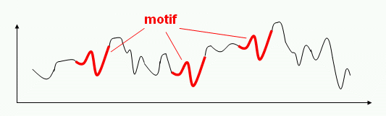
Time-series Motifs
Motifs: brief temporal shapes that repeat themselves approximately across the time-series
Typically, indicative of semantic properties, can be class discriminative
E.g. QRS complex in ECG, Hand swinging motion in HAR, Dicrotic notch in PPG
Key idea: If two sequences share similar motifs, then they are a good candidate to form positive pairs
Motifs present in Time-series
Notes:
We frame our challenge around mobile health, the study of how mobile devices can be used to track and enable healthy behaviors to hopefully prevent chronic diseases
This is typically done through sensors that continuously and noninvasively monitor our given conditions.

Slide 13
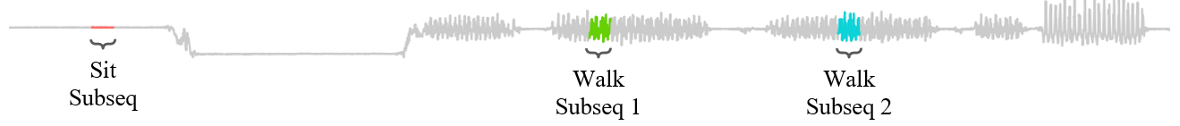
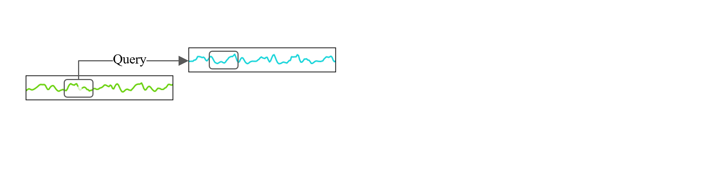
Intuition of our REBAR method
Given this accelerometry signal, with Walk Subsequence 1 as our anchor, we would like to determine if Walk Subsequence 2 or Sit Subsequence should be positive.
Key Idea: If we can successfully retrieve motif information from the candidate subsequence to aid in reconstruction of the anchor, then the candidate should be labeled as positive.

Slide 14
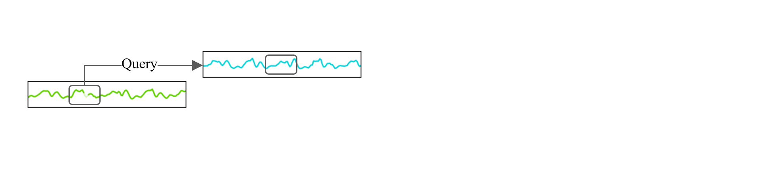
Intuition of our REBAR method
Given this accelerometry signal, with Walk Subsequence 1 as our anchor, we would like to determine if Walk Subsequence 2 or Sit Subsequence should be positive.
Key Idea: If we can successfully retrieve motif information from the candidate subsequence to aid in reconstruction of the anchor, then the candidate should be labeled as positive.

Slide 15
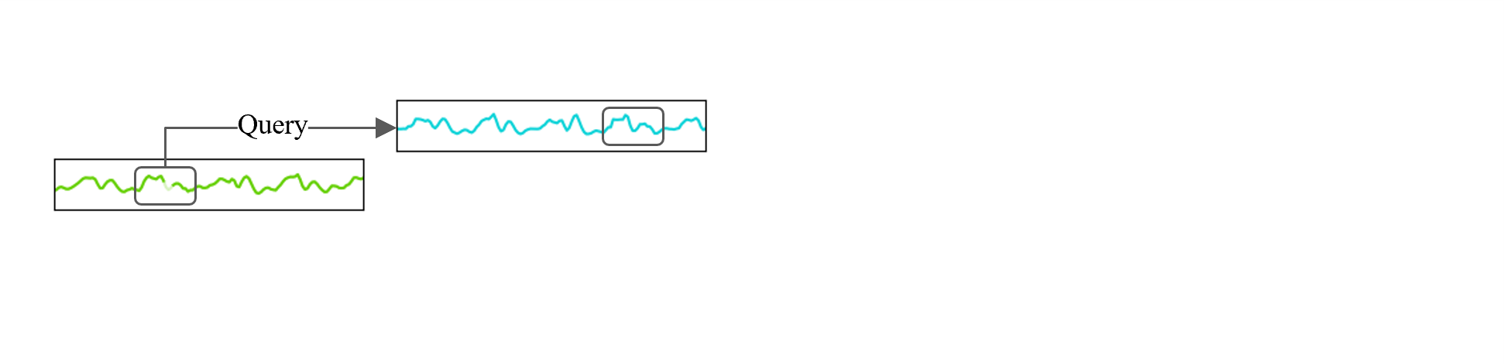
Intuition of our REBAR method
Given this accelerometry signal, with Walk Subsequence 1 as our anchor, we would like to determine if Walk Subsequence 2 or Sit Subsequence should be positive.
Key Idea: If we can successfully retrieve motif information from the candidate subsequence to aid in reconstruction of the anchor, then the candidate should be labeled as positive.

Slide 16
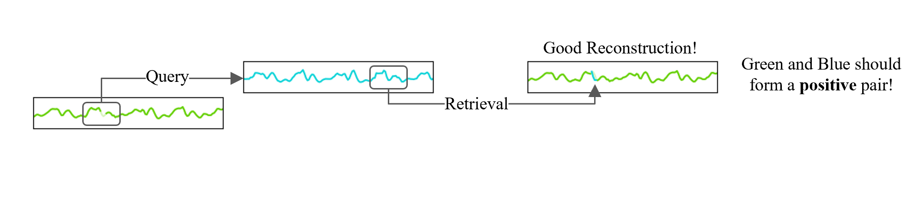
Intuition of our REBAR method
Given this accelerometry signal, with Walk Subsequence 1 as our anchor, we would like to determine if Walk Subsequence 2 or Sit Subsequence should be positive.
Key Idea: If we can successfully retrieve motif information from the candidate subsequence to aid in reconstruction of the anchor, then the candidate should be labeled as positive.

Slide 17
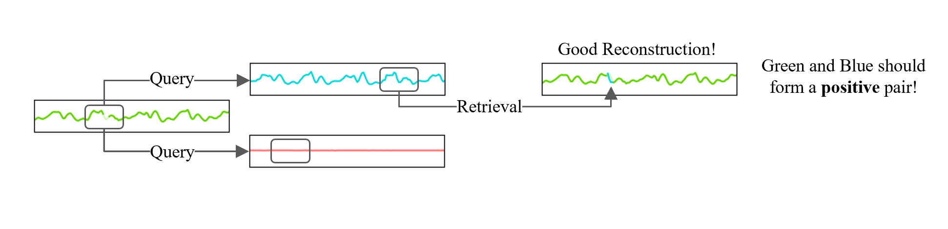
Intuition of our REBAR method
Given this accelerometry signal, with Walk Subsequence 1 as our anchor, we would like to determine if Walk Subsequence 2 or Sit Subsequence should be positive.
Key Idea: If we can successfully retrieve motif information from the candidate subsequence to aid in reconstruction of the anchor, then the candidate should be labeled as positive.

Slide 18
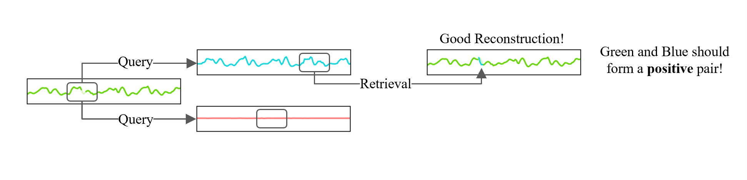
Intuition of our REBAR method
Given this accelerometry signal, with Walk Subsequence 1 as our anchor, we would like to determine if Walk Subsequence 2 or Sit Subsequence should be positive.
Key Idea: If we can successfully retrieve motif information from the candidate subsequence to aid in reconstruction of the anchor, then the candidate should be labeled as positive.

Slide 19
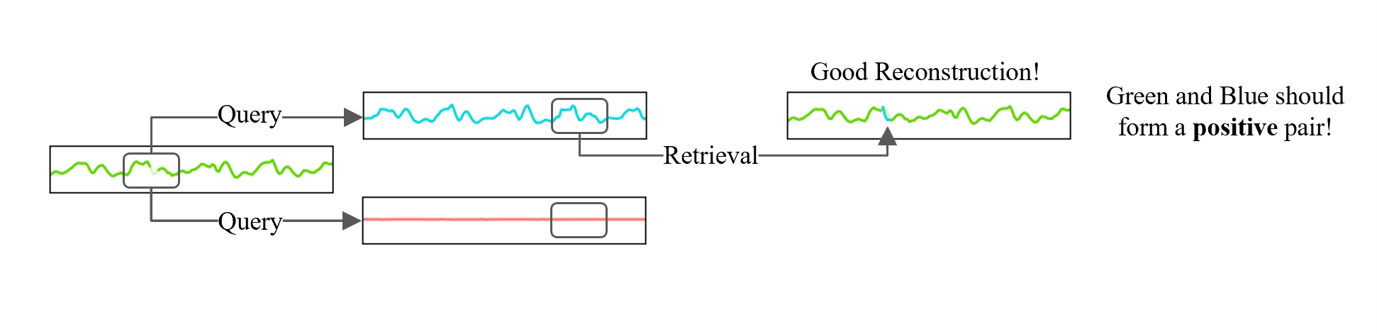
Intuition of our REBAR method
Given this accelerometry signal, with Walk Subsequence 1 as our anchor, we would like to determine if Walk Subsequence 2 or Sit Subsequence should be positive.
Key Idea: If we can successfully retrieve motif information from the candidate subsequence to aid in reconstruction of the anchor, then the candidate should be labeled as positive.

Slide 20
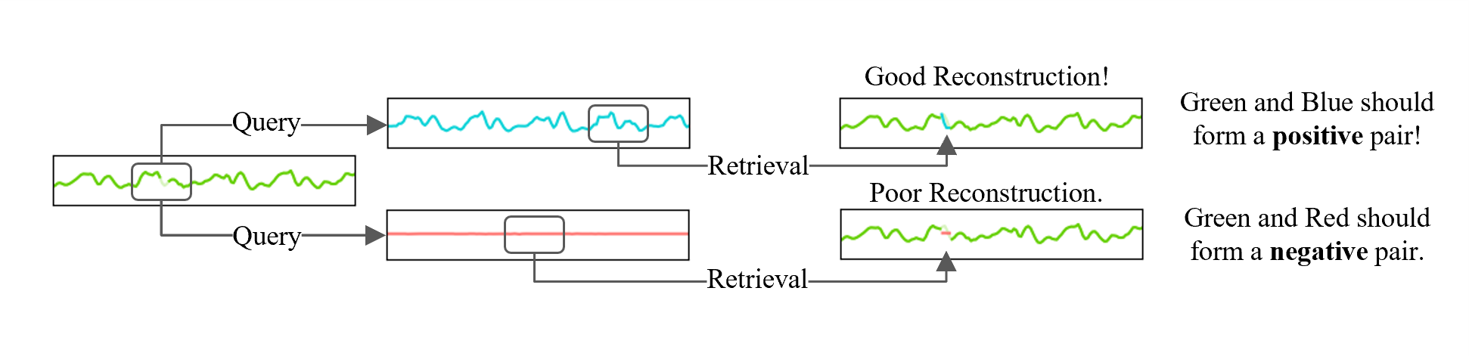
Intuition of our REBAR method
Given this accelerometry signal, with Walk Subsequence 1 as our anchor, we would like to determine if Walk Subsequence 2 or Sit Subsequence should be positive.
Key Idea: If we can successfully retrieve motif information from the candidate subsequence to aid in reconstruction of the anchor, then the candidate should be labeled as positive.

Slide 21
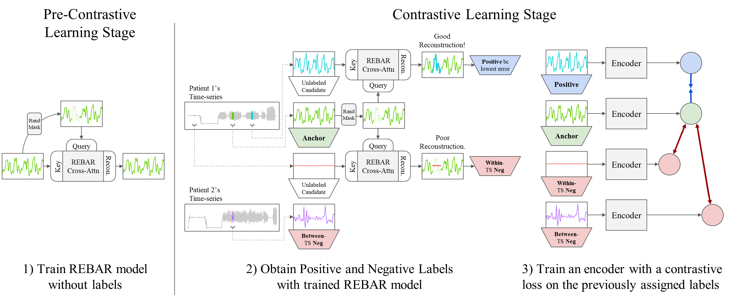
REBAR Approach

Slide 22
REBAR Approach

Slide 23
REBAR Approach

Slide 24
REBAR Contributions
This is the first work to use a similarity measure to select positive and negative pairs in time-series contrastive learning
We demonstrate that our learned measure predicts mutual class membership
Our REBAR contrastive learning approach achieves SOTA performance

Slide 25
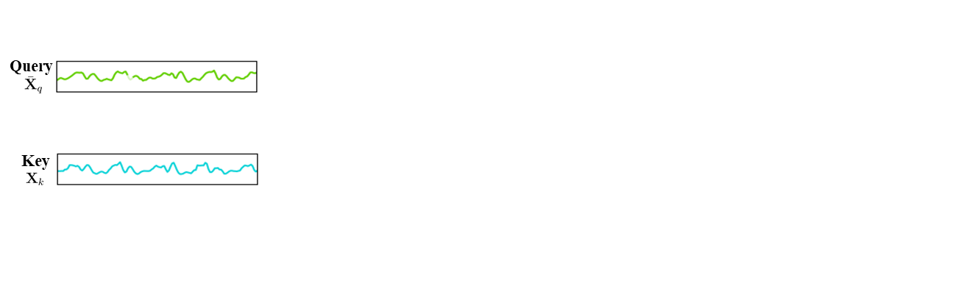
Design of REBAR Cross-Attention Model
Goal: The retrieval-based reconstruction error should be class-discriminative, such that pairs with better reconstruction are more likely to be semantically related.

Slide 26
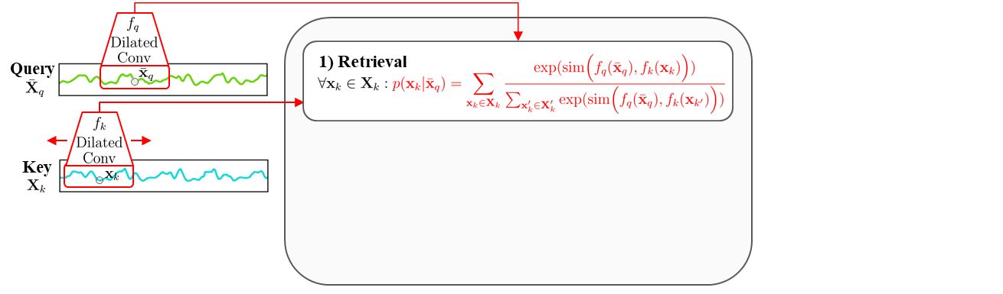
Design of REBAR Cross-Attention Model
Goal: The retrieval-based reconstruction error should be class-discriminative, such that pairs with better reconstruction are more likely to be semantically related.
1) Retrieval Step
The retrieval function identifies time points in the key useful for reconstructing based on the motif similarity.
REBAR Cross-Attention reconstruction of a single masked-out point, ${\overline{x}}_{q}$

Slide 27
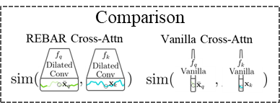
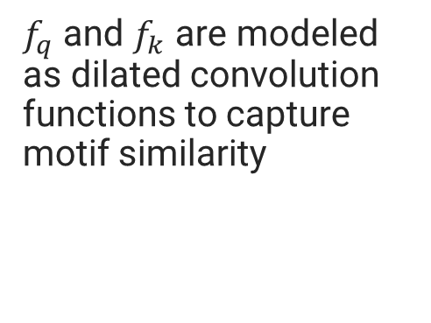
Design of REBAR Cross-Attention Model
Goal: The retrieval-based reconstruction error should be class-discriminative, such that pairs with better reconstruction are more likely to be semantically related.
$f_{q}$ and $f_{k}$ are modeled as dilated convolution functions to capture motif similarity
REBAR Cross-Attention reconstruction of a single masked-out point, ${\overline{x}}_{q}$

Slide 28
Design of REBAR Cross-Attention Model
Goal: The retrieval-based reconstruction error should be class-discriminative, such that pairs with better reconstruction are more likely to be semantically related.
1) Retrieval Step
The retrieval function identifies time points in the key useful for reconstructing based on the motif similarity.
REBAR Cross-Attention reconstruction of a single masked-out point, ${\overline{x}}_{q}$

Slide 29
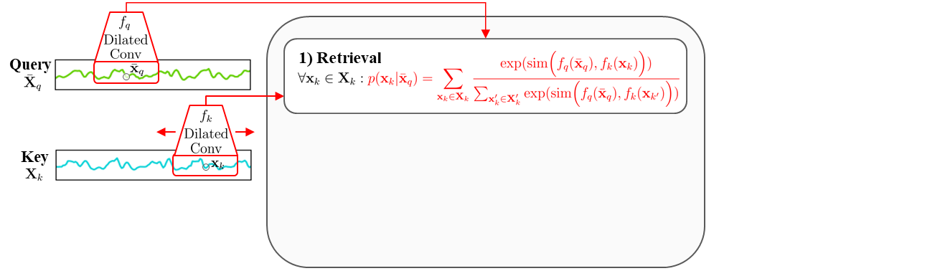
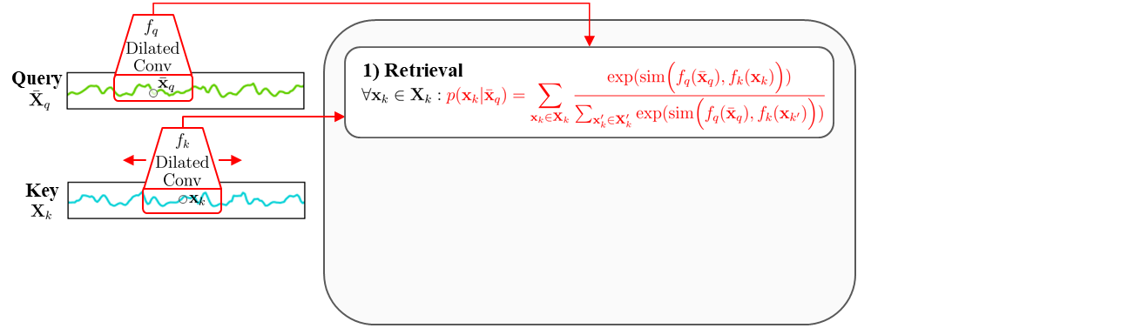
Design of REBAR Cross-Attention Model
Goal: The retrieval-based reconstruction error should be class-discriminative, such that pairs with better reconstruction are more likely to be semantically related.
1) Retrieval Step
The retrieval function identifies time points in the key useful for reconstructing based on the motif similarity.
REBAR Cross-Attention reconstruction of a single masked-out point, ${\overline{x}}_{q}$

Slide 30
Design of REBAR Cross-Attention Model
Goal: The retrieval-based reconstruction error should be class-discriminative, such that pairs with better reconstruction are more likely to be semantically related.
1) Retrieval Step
The retrieval function identifies time points in the key useful for reconstructing based on the motif similarity.
REBAR Cross-Attention reconstruction of a single masked-out point, ${\overline{x}}_{q}$

Slide 31
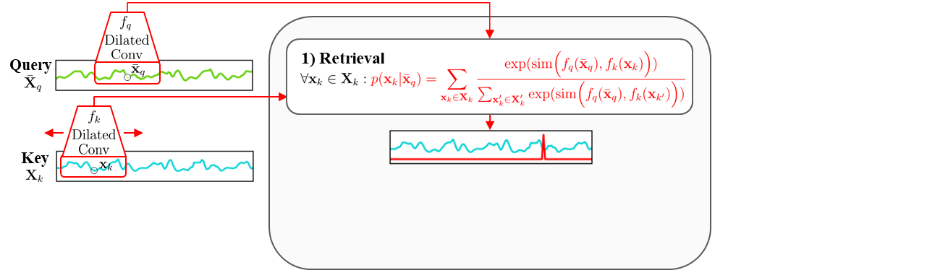
Design of REBAR Cross-Attention Model
Goal: The retrieval-based reconstruction error should be class-discriminative, such that pairs with better reconstruction are more likely to be semantically related.
1) Retrieval Step
The retrieval function identifies time points in the key useful for reconstructing based on the motif similarity.
This gives us an attention distribution over the key sequence
REBAR Cross-Attention reconstruction of a single masked-out point, ${\overline{x}}_{q}$

Slide 32
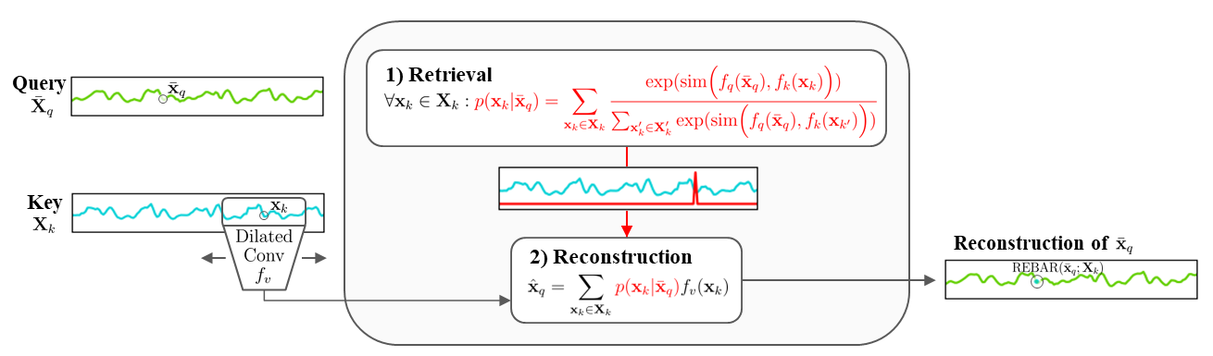
Design of REBAR Cross-Attention Model
Goal: The retrieval-based reconstruction error should be class-discriminative, such that pairs with better reconstruction are more likely to be semantically related.
2) Reconstruction Step
A weighted average of the retrieved regions is used to reconstruct the missing point.
REBAR Cross-Attention reconstruction of a single masked-out point, ${\overline{x}}_{q}$

Slide 33
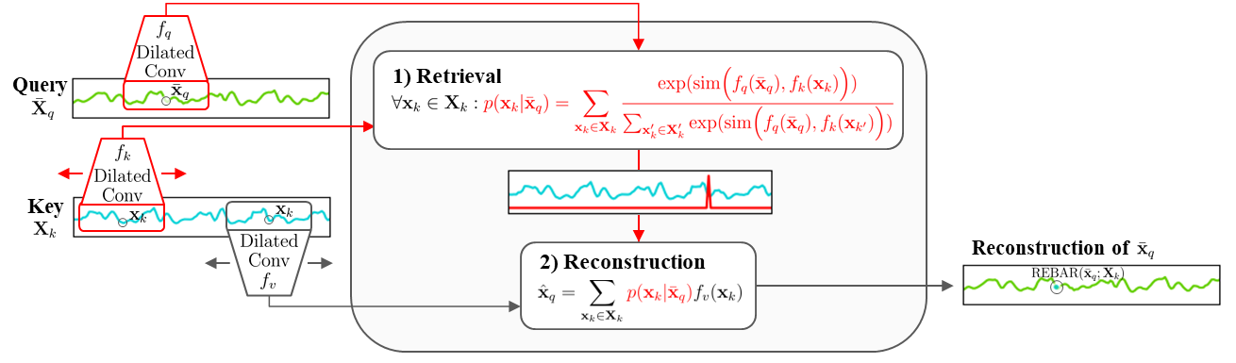
Design of REBAR Cross-Attention Model
The query is never directly used for reconstruction. Instead, reconstruction is directly dependent on the motif similarity between the query and key.
REBAR Cross-Attention reconstruction of a single masked-out point, ${\overline{x}}_{q}$

Slide 34
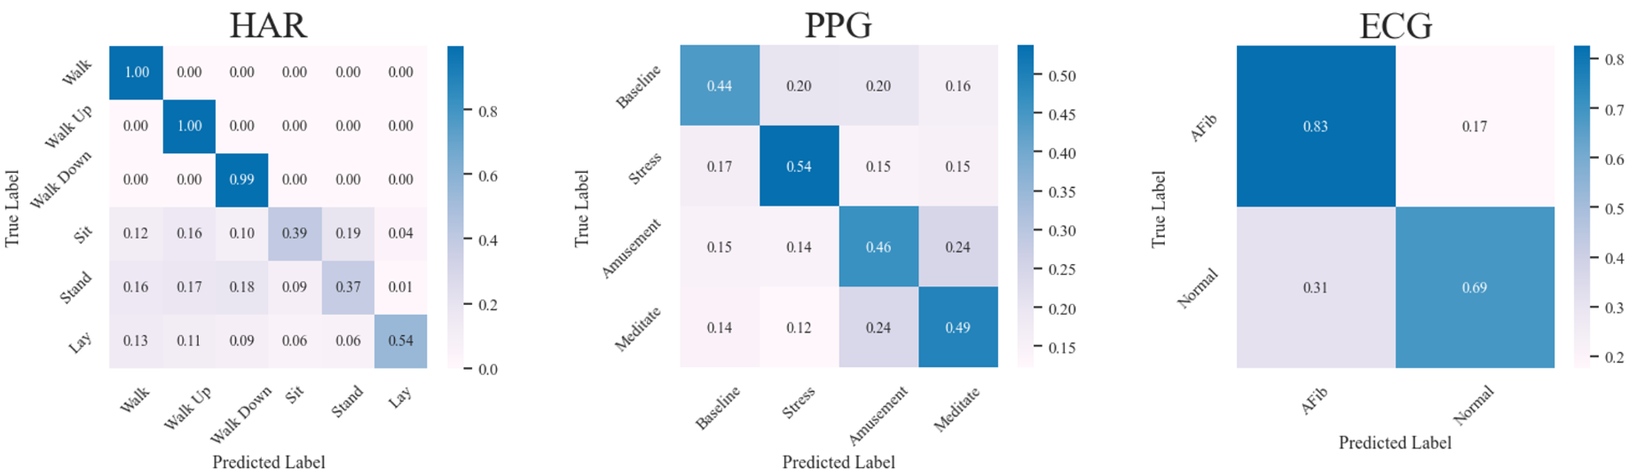
NN Validation Experiment before Contrastive Learning
After sampling a candidate from each class, label the anchor with a nearest neighbor classifier, with distance measured by REBAR error.
Visualization of results with a confusion matrix below. The high concentration on the diagonal demonstrate REBAR’s ability to predict mutual class membership without being trained with any labels.

Slide 35
Applying REBAR to Contrastive Learning
Randomly sample a set of candidate and an anchor subsequences from a given time-series, then:
The one with the lowest REBAR error is positive.
All other candidates are within-time-series negatives.
Within-TS Loss
Captures how a time-series evolves over time, e.g. how activity signals changes over time

Slide 36
Applying REBAR to Contrastive Learning
Randomly sample a set of candidate and an anchor subsequences from a given time-series, then:
The one with the lowest REBAR error is positive.
Captures differences in individuals, e.g. how each patient has a unique physiologies resulting in different ECGs
All other candidates are within-time-series negatives.
Within-TS Loss
Other subsequences from other time-series are
between-time-series negatives.
Between-TS Loss

Slide 37
Applying REBAR to Contrastive Learning
Randomly sample a set of candidate and an anchor subsequences from a given time-series, then:
The one with the lowest REBAR error is positive.
Convex combination that can be tuned if desired.
All other candidates are within-time-series negatives.
Within-TS Loss
Combined Loss
Other subsequences from other time-series are
between-time-series negatives.
Between-TS Loss

Slide 38
Experimental Design
Representative benchmark suite that each train the same encoder, but in different ways:
TS2Vec, current SOTA augmentation-based method
TNC, sampling-based method
CPC, contrasts future predictions
SimCLR, uses most common augmentations (i.e. shifting, scaling, jittering)
Sliding-MSE, simplified version of REBAR for evaluating pairwise similarity
Data Domains:
HAR, PPG, ECG
Downstream Evaluation:
Linear Probe (i.e. logistic regression on frozen encoding)
Cluster Agreement with Class Labels (i.e. k-means + Adjusted Rand Index and Normalized Mutual Information)

Slide 39
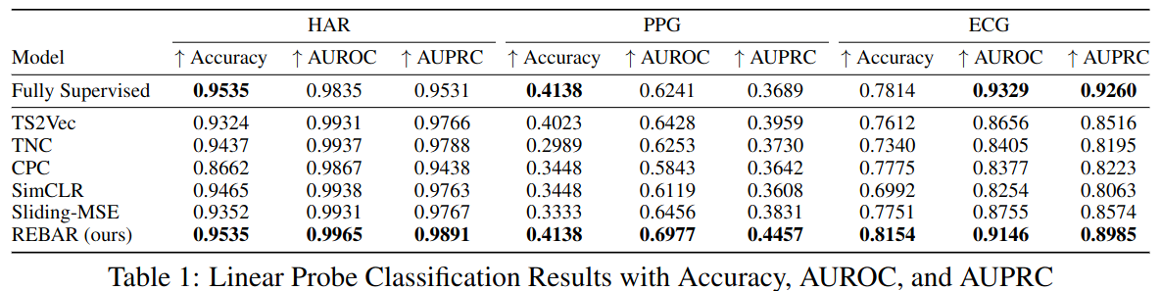
Downstream Linear Probe Results
REBAR consistently achieved the strongest results, beating a wide range of representative augmentation-based and sampling-based contrastive methods, even beating a fully-supervised approach.

Slide 40
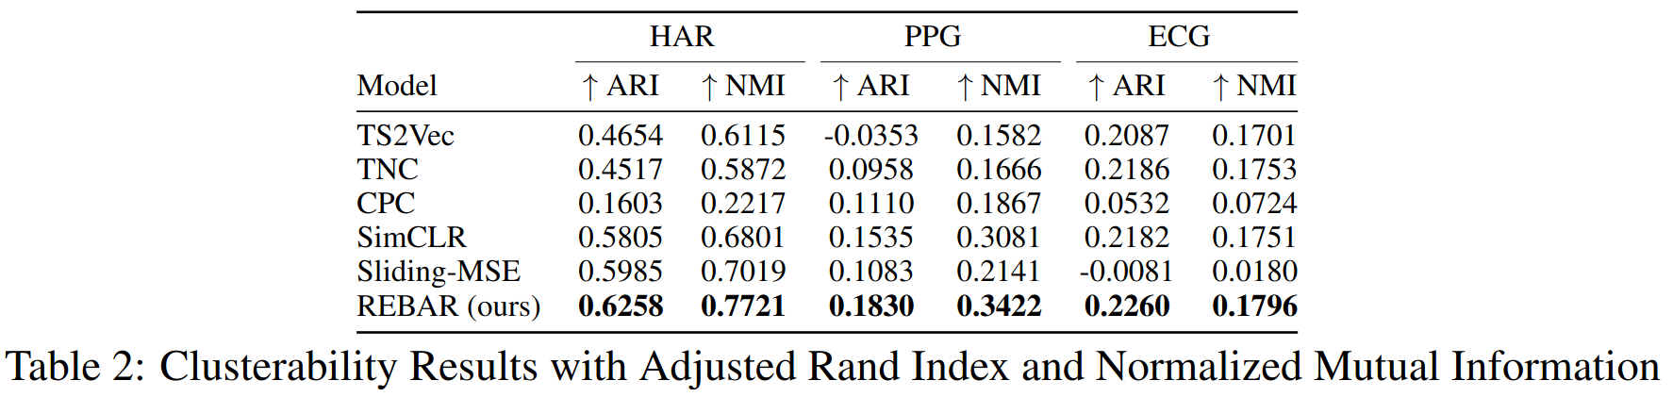
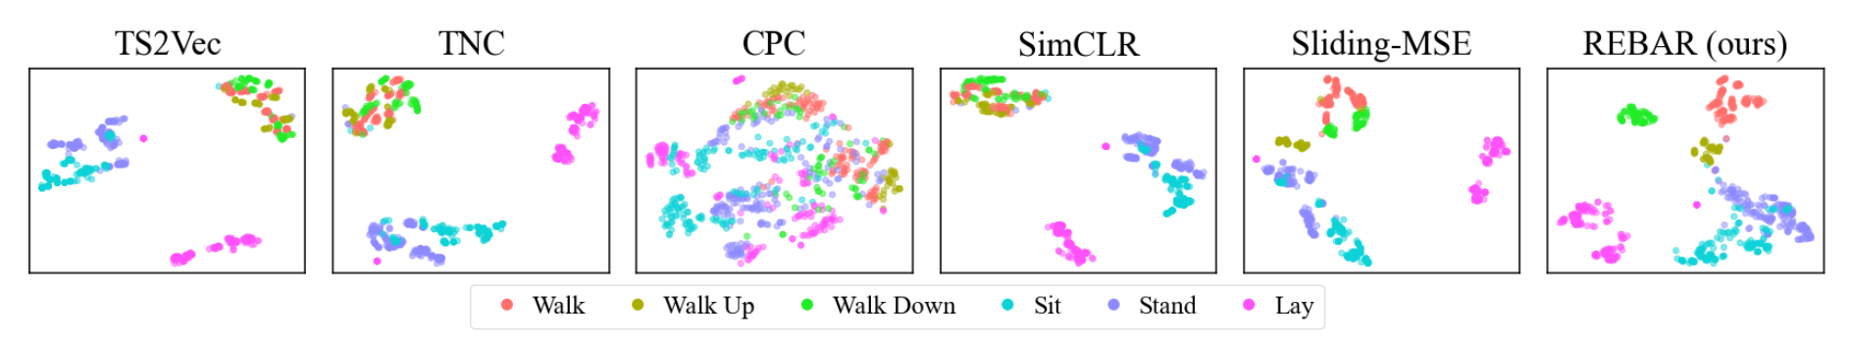
Downstream Clustering Results
Clusterability results demonstrate that REBAR has a strong agreement between k-mean clusters and true labels, corroborating classification results.
In the t-SNE visualization for HAR, unlike most methods, REBAR is able to distinguish between the walk, walk up, and walk down labels.

Slide 41
Downstream Clustering Results
Clusterability results demonstrate that REBAR has a strong agreement between k-mean clusters and true labels, corroborating classification results.
In the t-SNE visualization for HAR, unlike most methods, REBAR is able to distinguish between the walk, walk up, and walk down labels.

Slide 42
Conclusion
Our REBAR method offers a powerful new perspective on how to identify positive pairings in time-series contrastive learning, and we hope that this work will drive future research into understanding how to best learn representations in time-series and the greater contrastive learning space.

Slide 43
Appendix

Slide 44
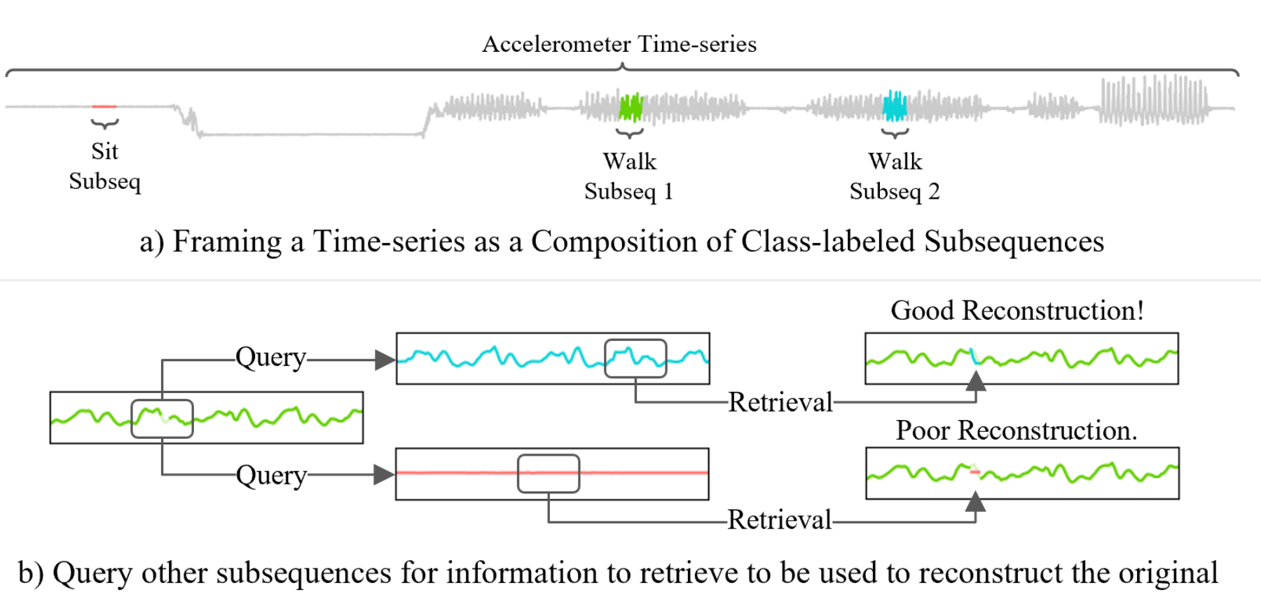
What if positive pairs are far from each other?
For example, given this accelerometry signal where the user
In a temporal proximity, sampling-based approach, subsequences from Walking 1 would sooner form positive examples with the Stop area than the other Walk 2 area.
Without labels, how could we identify Walk Subseq 1 and Walk Subseq 2 as candidates to form a positive pair?
1) Started Walking 2) Stopped 3) Started Walking again
fix
Notes:
We frame our challenge around mobile health, the study of how mobile devices can be used to track and enable healthy behaviors to hopefully prevent chronic diseases
This is typically done through sensors that continuously and noninvasively monitor our given conditions.

Slide 45
Positive Pairs in Prior Work
Augmentation-based approaches
Originate from vision domain
Cameras have a much better-established set of invariances compared to time-series
↓
Inconsistent set of augmentations in time-series approaches
TF-C uses jittering+scaling while TS2Vec explicitly excludes them
Sampling-based Approaches
Identify positive pairs from as subsequences within a longer time-series
Typically, naively uses temporal proximity to identify positive pairs (e.g. TNC, T-loss)
SimCLR Approach
TNC Approach

